Slide 1
11.20.2019
Machine Learning In TensorFlow
Kevin Ford
kevinf@magenic.com
617 359-5192

Slide 2
https://github.com/Magenic/MLTraining

Slide 3
An Introduction to Neural Networks
Traditional Binary Classification Machine Learning
Representation Binary Classification Machine Learning
Data
Notes:
Data
Feature Extraction
Classification Result

Slide 4
Neural Networks with Deep Learning
Deep Learning – calculate what features matter
Neural Networks – The most common type of Deep Learning
Neurons– Building blocks for Neural Networks that individually learn

Slide 6
An Introduction to Neural Networks
Traditional Binary Classification Machine Learning
Data
Layer 1
Layer 2
Layer 3
Layer n

Slide 7
An Introduction to Neural Networks
Traditional Binary Classification Machine Learning
Data
Pixels
Processed Pixel information

Slide 8
Deep Learning can find patterns in large sets of data that are not obvious even to experts

Slide 9
TensorFlow
Created by Google
Specializes in Deep Learning
Uses Python
Has a lightweight version, TensorFlow Lite for mobile/embedded systems
Tries to handle some of the complexity of creating neural networks
Works well with huge amounts of data: training and evaluation can be scaled

Slide 10
Lab 8: The TensorFlow Hello World (10 minutes)

Slide 11
Some TensorFlow Concepts
Directed Acyclic Graph
Network
Nodes
Tensors
Notes:
Everything is a directed acyclic graph – everything flows in one direction
Network – A graph with nodes
Nodes – individual Computations (circles on the image)
Tensor – the mapping between data moving from one Node to another (lines on the picture)
This is where TensorFlow gets its name. It is the flow of data through the nodes to get a final result
Tensorflow is good at modeling neural networks because it is modeled like one. The nodes represent neurons in a neural network

Slide 12
Tensors
Tensors are n-dimensional arrays of data
Tensors must be of same type (numbers, strings, bools)
Tensors have a shape which defines the lengths of a tensor’s dimensions
Scaler – (0,) - zero dimensions, just a single value
Vector – (4,) – one dimension of four values
Matrix – (2, 4) – two dimensions of four values each

Slide 13
Lab 9: Simple Tensors (10 minutes)

Slide 14
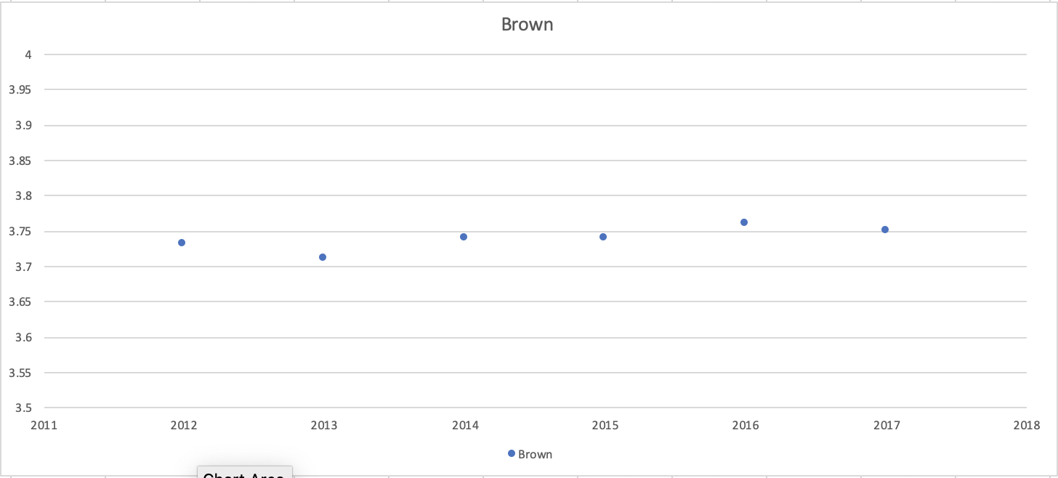
A Simple Regression On TensorFlow

Slide 15
What’s in a line?

Slide 16
How Far is Your Line Off?
Mean Squared Error
Notes:
N – number of samples
yi - predicted outcome
Yi (hat) – target outcome
Mean squared error – Measures the average of the squares of the errors

Slide 17
Adjusting the Line
Notes:
0 – our parameter
a – learning rate / step size
Loss – loss function
Implication – the larger the mean squared error, the larger the adjustment

Slide 18
Process For Creating a Regression Model
Load Data
Split Data
Train Data
Check Model

Slide 19
Some Important TensorFlow Classes and Commands
tf.data.experimental.CsvDataset – loads cdv data
tf.split – splits a multi-dimensional tensor
Sequential – A stack of layers, a TensorFlow model
Dense – A standard layer
model.fit – Train a model

Slide 20
Keras
Notes:
Keras is an open-source neural-network library written in Python. It is capable of running on top of TensorFlow, Microsoft Cognitive Toolkit, R, Theano, or PlaidML.
Really a standard interface

Slide 21
Rectified Linear Activation (relu)
Notes:
Negatives and 0 have a zero value and other units are returned as is

Slide 22
Linear Activation
Does not alter the data but only alters the output shape

Slide 23
Lab 10: Do a Regression in TensorFlow (30 minutes)

Slide 24
Ways to Host a TensorFlow Model
Notes:
Cloud ML
IBM Watson
Docker container
Convert to TensorFlow Lite and run in mobile app
Rstudio
Azure
AWS

Slide 25
Lab 11: Host our Regression Model (20 minutes)

Slide 26
Image Recognition

Slide 27
What we are looking for
Edges, Colors, Shapes

Slide 28
Remember this?
Traditional Binary Classification Machine Learning
Data
Pixels
Processed Pixel information

Slide 29
Convolutional Neural Networks are popular for image recognition
Convolution
(Local receptive field)
Pooling
(Subsampling of inputs, reduces size of image)
Stride
How far to move to the next sample area
Notes:
Convolution – building block of CNNs a scan/computation of a single piece

Slide 30
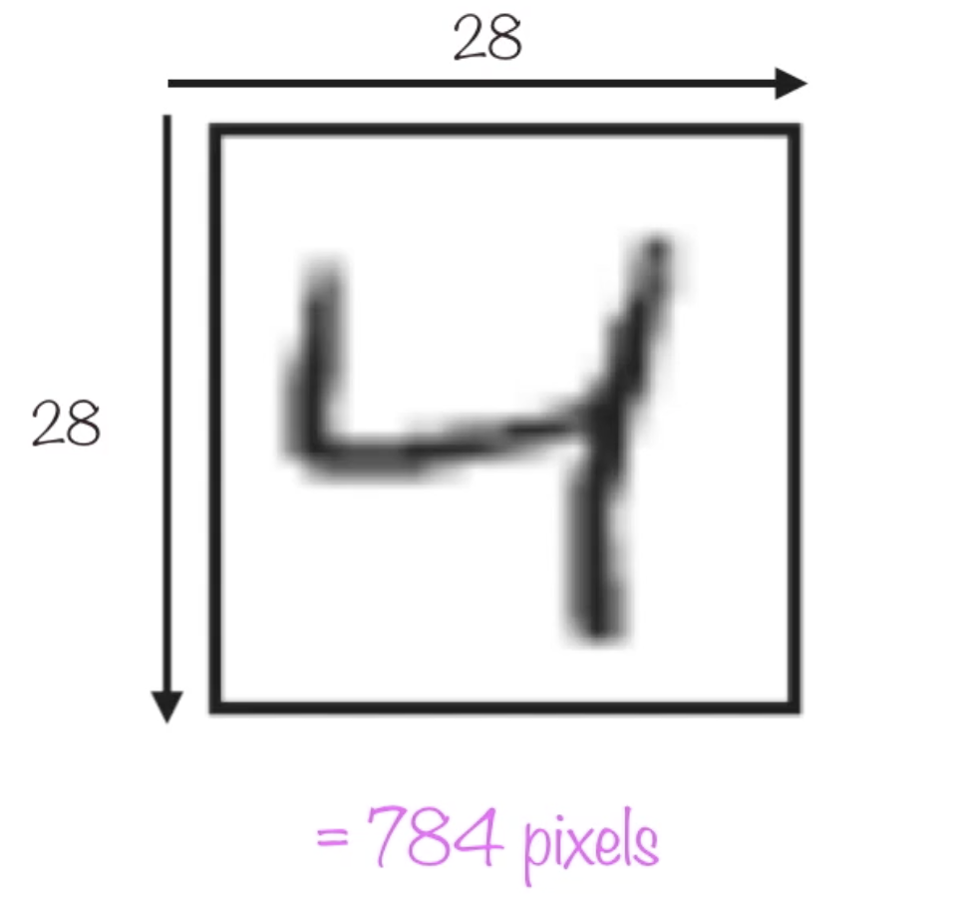
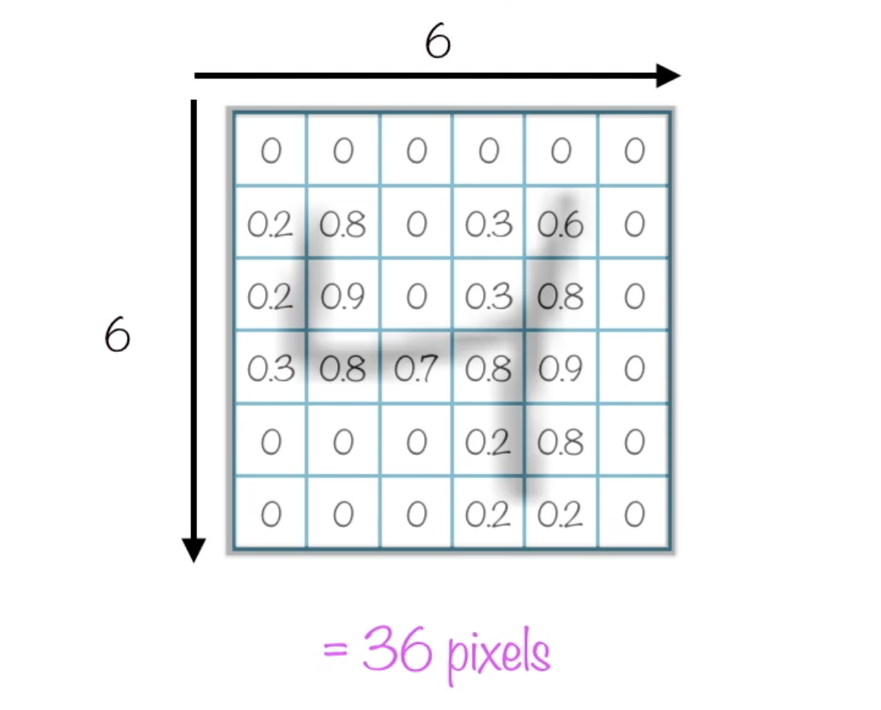
Convolution

Slide 31
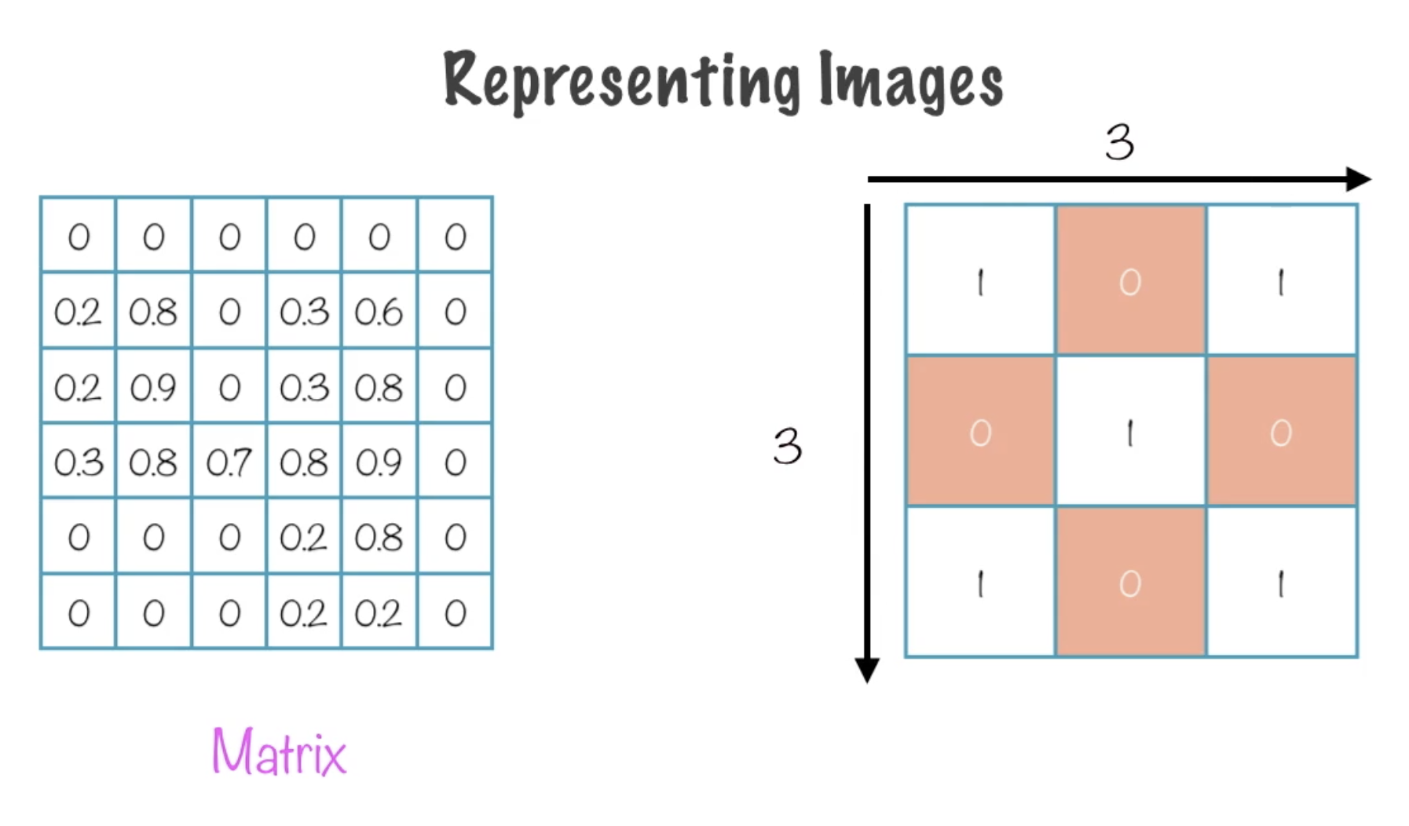
Convolution

Slide 32
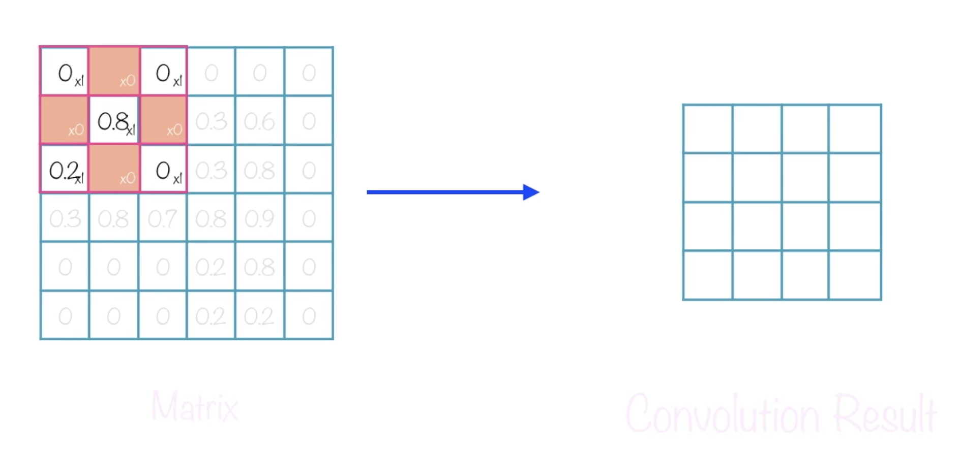
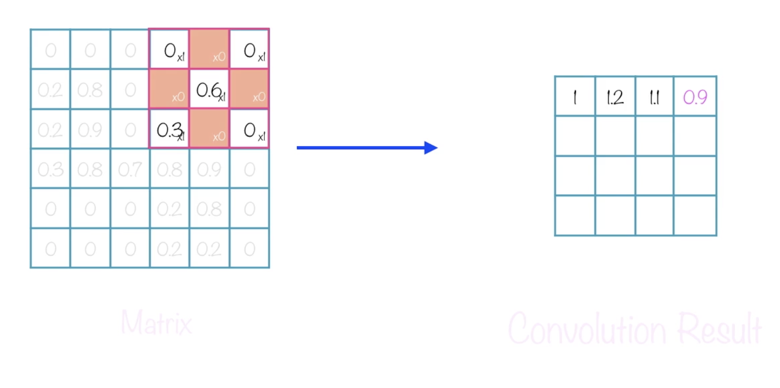
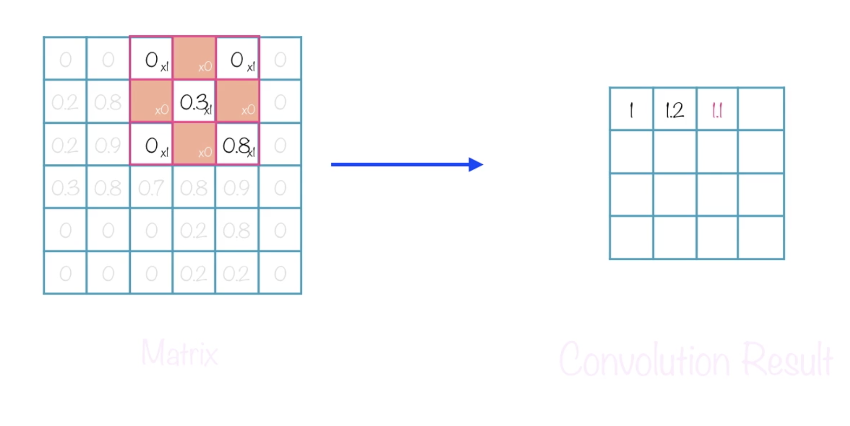
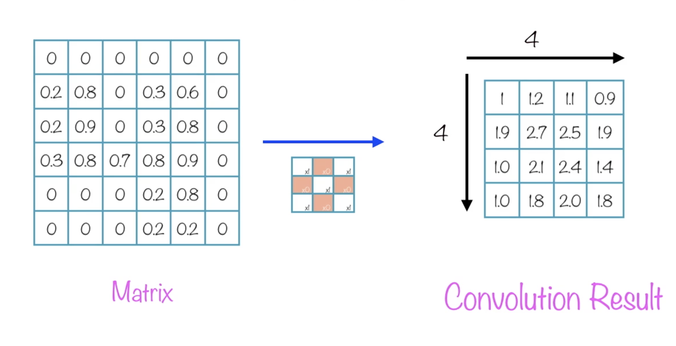
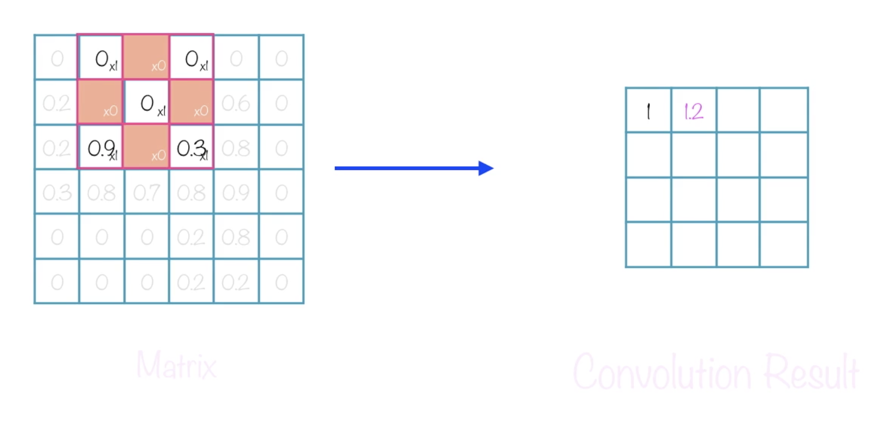
Convolution - Borders can be added to get edge data
Notes:
Moving a filter across the image
Finite number of convolutions as filters make the images “smaller”

Slide 33
Sigmoid
Notes:
Good for binary classification functions. Outputs values in a range of 0-1. Flattens out outliers and accentuates small variations

Slide 34
Categorical Crossentropy
categorical crossentropy vs sparse categorical crossentropy
Notes:
Type of Crossentropy loss

Slide 35
Lab 12: Image classification (30 minutes)

Slide 36
Softmax (AKA Multinomial Logistic Regression)
When you want to use several independent variables
Between 0 and 1
softmax of x is calculated by exp(x)/tf.reduce_sum(exp(x)).
Usually the last layer called

Slide 37
Lab 13: Multinomial Logistic Regression (30 minutes)

Slide 38
Q & A

